Slide 1




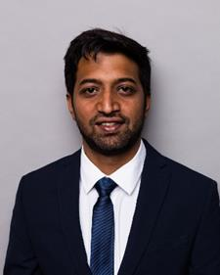
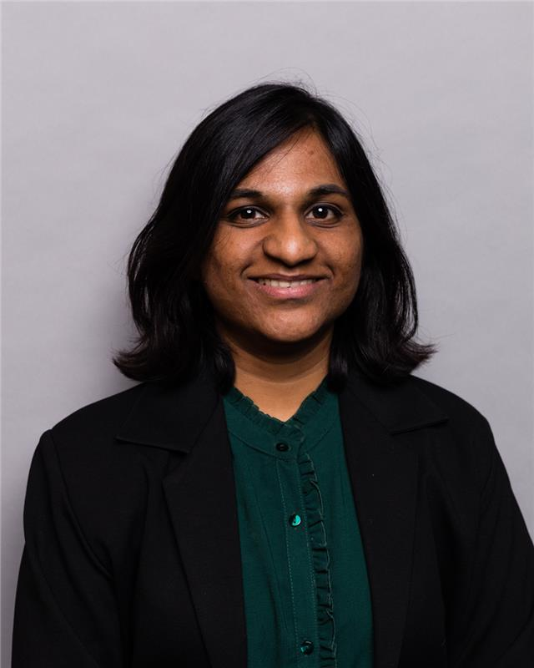
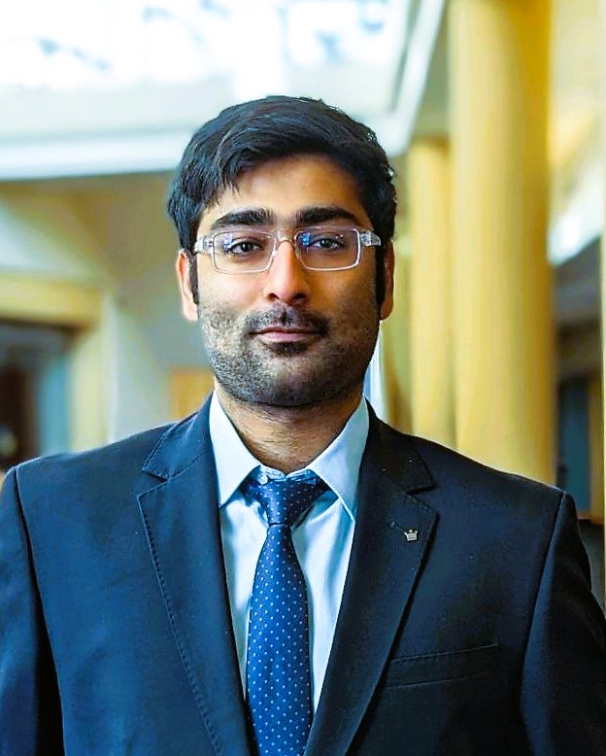
Language agnostic readability assessments
Amal Tom
Zscaler | Purdue
Mrinmoy Dalal
Deloitte | Purdue
Sankarsan Gautam
HSBC | Purdue
Shreyas Joshi
Quotient | Purdue
Vedanti Gulalkari
Deloitte | Purdue
Venkatesh Seetha
i.Di Gov | Purdue
BAIM ANALYTICA
20+ years of combined analytics and consulting experience

Slide 2





Agenda
Methodology
Demonstration
Problem Statement
Statistical Results
Future Scope

Slide 3
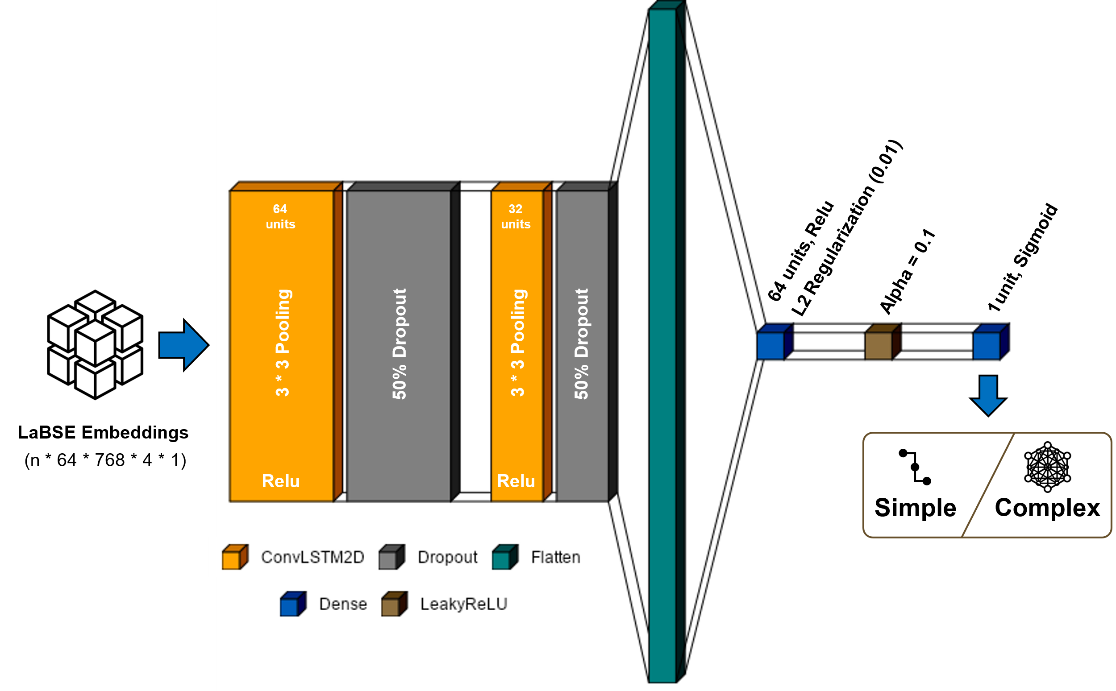




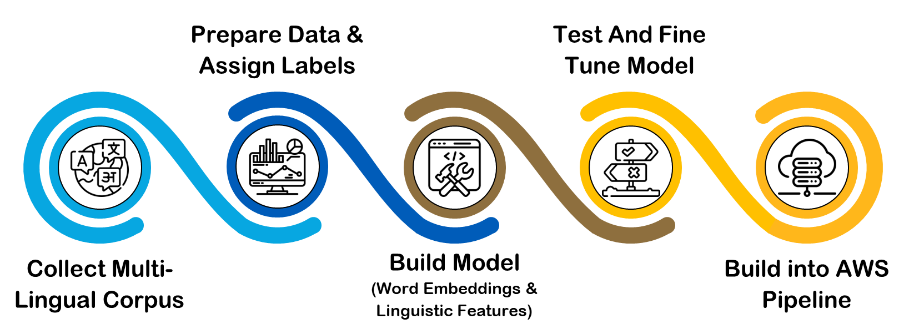

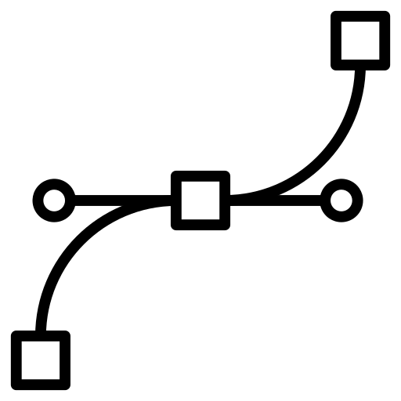


Executive summary
Challenge
Engineer a readability assessment model that can identify a piece of text as simple or complex without relying on the input language or its specific features.
Why?
Model Architecture
Impact
Readability models only available for specific languages
Develop digital resources for local language communities
Promote better communication and engagement regardless of language ability
1.1 billion
individuals
1600
communities
Writing local
language content: bring audience closer
Methodology
Facilitate multilingual education: identify age appropriate content
Each token in input text converted to 768 length vector
Convolutional LSTM model to capture patterns across spatial-temporal nature of input.
Content translation: consistency

Slide 4
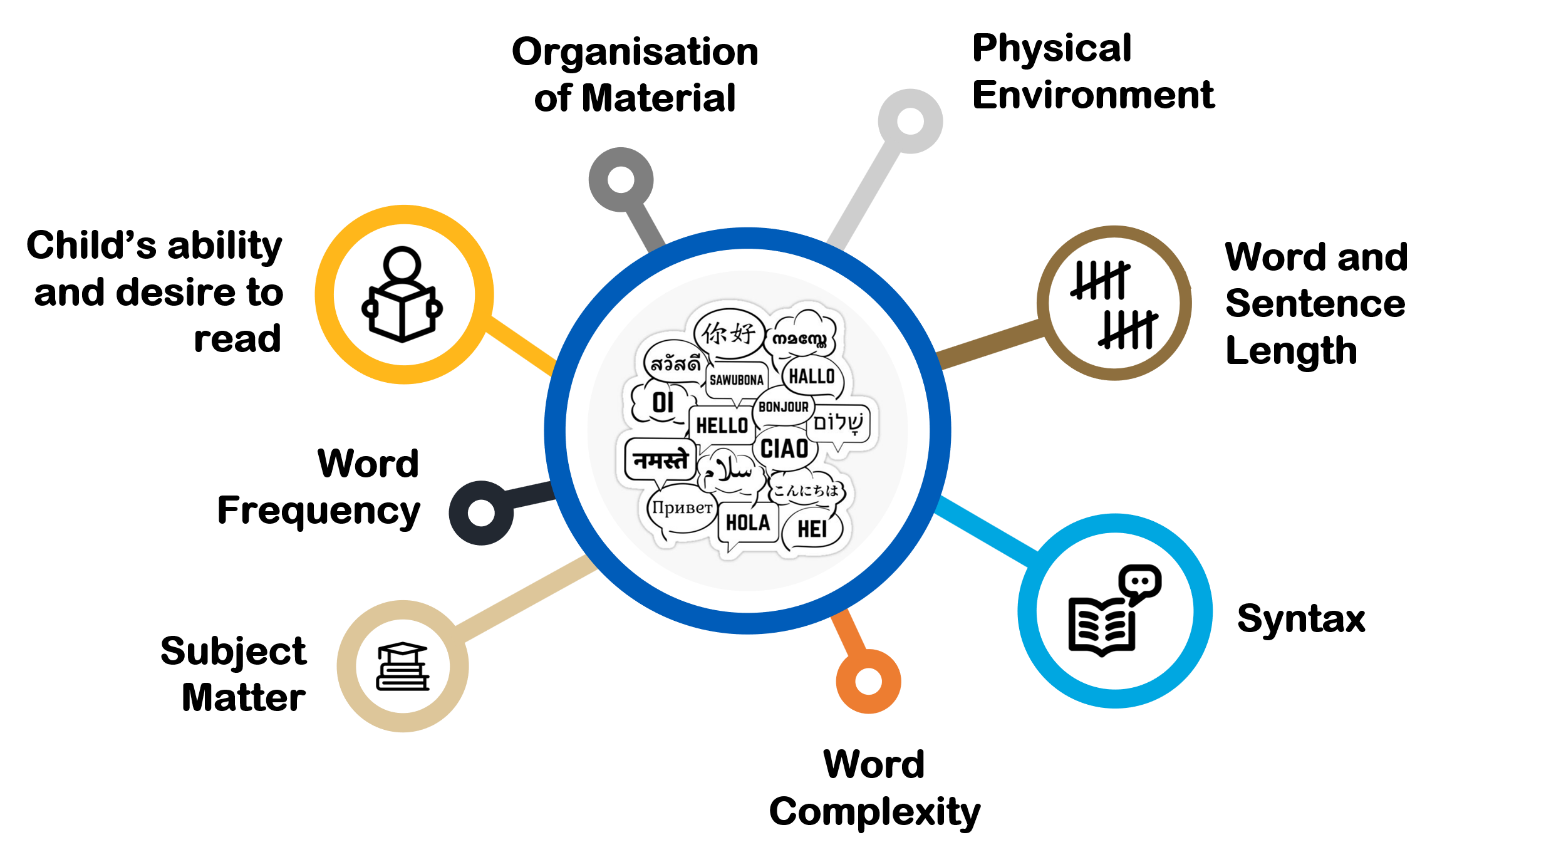
What are the factors for readability?

Slide 5



What are the factors for readability?
100 - 90
Very Easy
The campers built a fire and roasted marshmallows
< 30
Very difficult
The Schrödinger equation, a cornerstone of quantum mechanics, describes the evolution of a system's wave function over time.
Graduate (~30)
College (~52)
10th Grader (~65)

Slide 6

The problem
Can automated readability assessments discriminate between less readable and more readable text?
Can readability of text be assessed automatically in a mostly language agnostic manner?

Slide 7





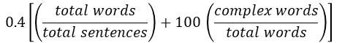

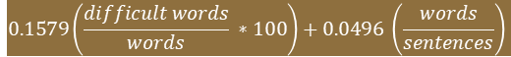
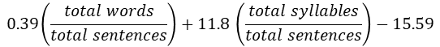
Readability metrics
$$206.835 −1.015\left(\frac{total words}{total sentences}\right)+84.6 \left(\frac{total syllables}{total sentences}\right)−15.59$$
Flesch Reading Ease
Common Feature Parameters
$$0.39\left(\frac{total words}{total sentences}\right)+11.8 \left(\frac{total syllables}{total sentences}\right)−15.59$$
Flesch Kincaid Grade Level
Word Frequency
No. of prepositional / adverb / gerund phrases
$$0.1579\left(\frac{difficult words}{words} ∗100\right)+0.0496 \left(\frac{words}{sentences}\right)$$
Dale – Chall Score (Raw)
Average sentence length
No. of difficult words in word list
Average word length
No. of syllables
$$0.4\left[\left(\frac{total words}{total sentences}\right)+100 \left(\frac{complex words}{total words}\right)\right]$$
Gunning Fog Index
Proportion of unique words
Characters per word
$$4.71\left(\frac{characters}{words}\right)+0.5 \left(\frac{words}{sentences}\right)−21.43$$
ARI
Gray-Leary, Golub Syntactic Density, Bormuth, Lexile, ATOS, etc.

Slide 8
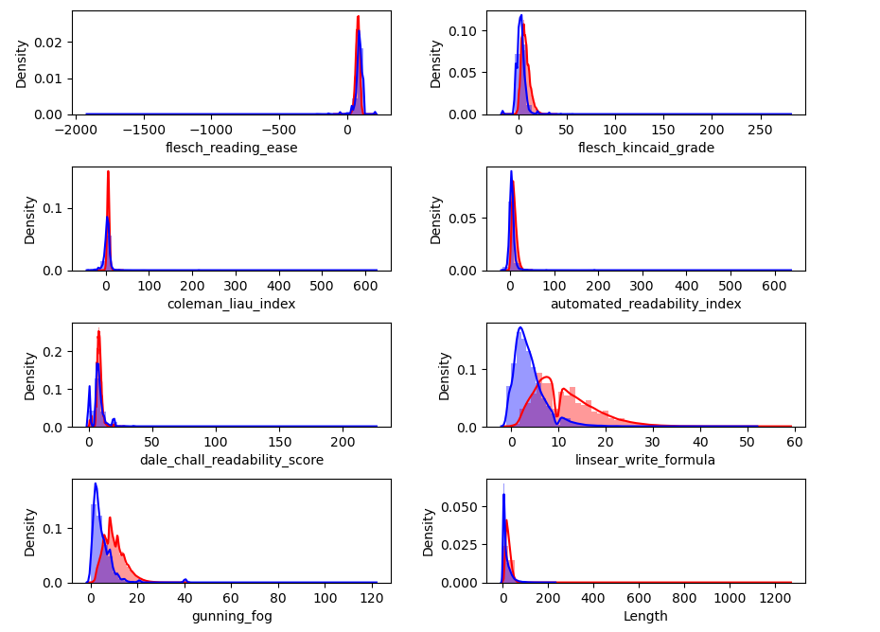
What are the issues with these metrics?
Language
Textstat Analysis: Most metrics struggle to clearly distinguish between simple and complex English sentences when they are of similar length
Only for English language
Dependence
Sentence and word lengths
Consensus
Cannot objectively define a difficult word
Context
Not context aware
Linearity
Non-linear complex relationships aren't captured
Purpose
Formulae are specific to tasks

Slide 9


Analytics challenge
Identify patterns and features of input
Success Metrics
Model accuracy
Averaged F1 scores
Recall
Precision
Across both target classes by language
ML Model
Complexity Score & label
Not rely on language specific syntax and rules

Slide 10
















Methodology
Prepare Data & Assign Labels
Test And Fine Tune Model
Python Package
Collect Multi-Lingual Corpus
Build Model
(Word Embeddings & Linguistic Features)
Build into AWS Pipeline
Use language-agnostic sentence embeddings from a LLM to facilitate transfer learning
Train supervised deep-learning models on labeled sentences from major language families
Employ zero-shot learning to predict the complexity score of multi-lingual verses
Conduct training & prediction in embedding space to eliminate costly language-specific processing
Deploy the solution as an AWS pipeline for optimal performance at scale
Sagemaker
S3 Bucket

Slide 11


Data collection and processing
Data collection
Generate embeddings
Bloom Library
WordPiece Tokenized Sentence
( N * 64 * 768 * 4 ) embeddings
Complexity labelled data
The Bible
TextStat Labelling
Custom labelled data
40-to-50-word length
Numpy Dataframe
Freeze all 12 LaBSE layers
Extract word level embeddings (last 4 layers)
Leipzig News Corpora
OneStop English Corpus
80 : 20 Split
Other pre - labelled corpora
Word Piece Tokenized Sentence
Fine tune LaBSE model
Freeze all 12 LaBSE layers
Attach classification head
Epochs: 10
Learning rate: 5e-6
Weight decay: 0.01
Future Exploration
Unfreeze last 6 layers
Fine-tune LaBSE embeddings

Slide 12





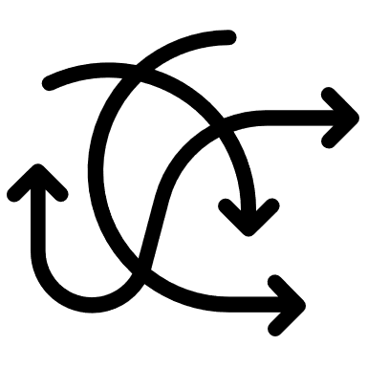



Test data
12671
ISO (3 letter identifier):
Language code for sentences
Sentence Pairs
Sentence pairs sourced from
Bible and public datasets
TEST DATASET INFORMATION
29
POINTS OF INTEREST
Script Type (Categorical):
Alphabet or symbols
Languages
Sentence in each pair contains one, several or fragments of sentence(s)
~500
] [
White Space (Boolean):
If language contains whitespaces
Pairs per language
Sentence complexity within
pair is relative
5
Text pairs may or may not semantically related
Complicated (String):
Complex sentence example
Script Families
3
Simple text may be longer than complex text
Simple (String):
Simple sentence example
Languages w/o whitespace separator

Slide 13
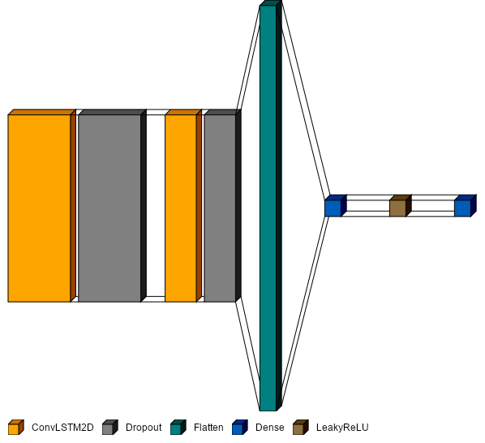







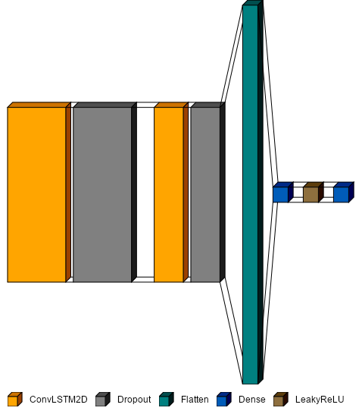
Model architecture
Epochs: 10
Batch size: 64
Loss function: Binary Cross-entropy
64 units
32 units
64 units, Relu
L2 Regularization (0.01)
Alpha = 0.1
1 unit, Sigmoid
Epoch | Loss | Accuracy
1 | 0.4266 | 0.8262
2 | 0.2822 | 0.8808
3 | 0.2308 | 0.9011
4 | 0.2024 | 0.9112
5 | 0.1663 | 0.9257
6 | 0.1459 | 0.9355
7 | 0.1286 | 0.9427
8 | 0.1067 | 0.9519
9 | 0.0946 | 0.9580
10 | 0.0858 | 0.9632
3 * 3 Kernel
50% Dropout
50% Dropout
3 * 3 Kernel
LaBSE Embeddings
(N * 64 * 768 * 4 * 1)
Relu
Relu
Simple
Complex

Slide 14
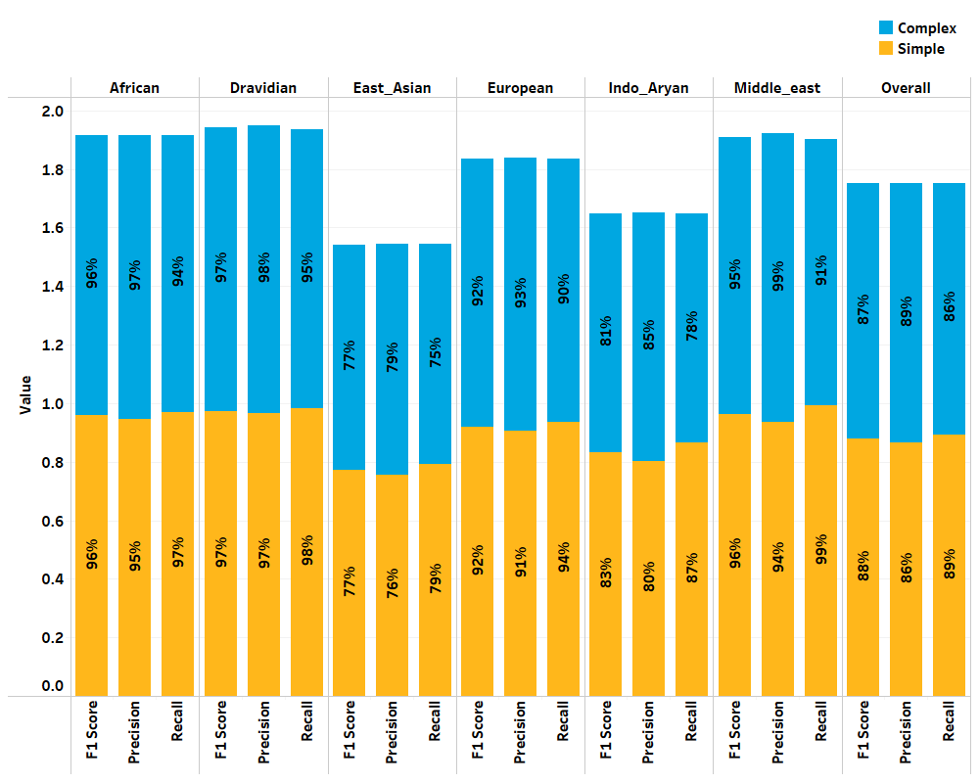
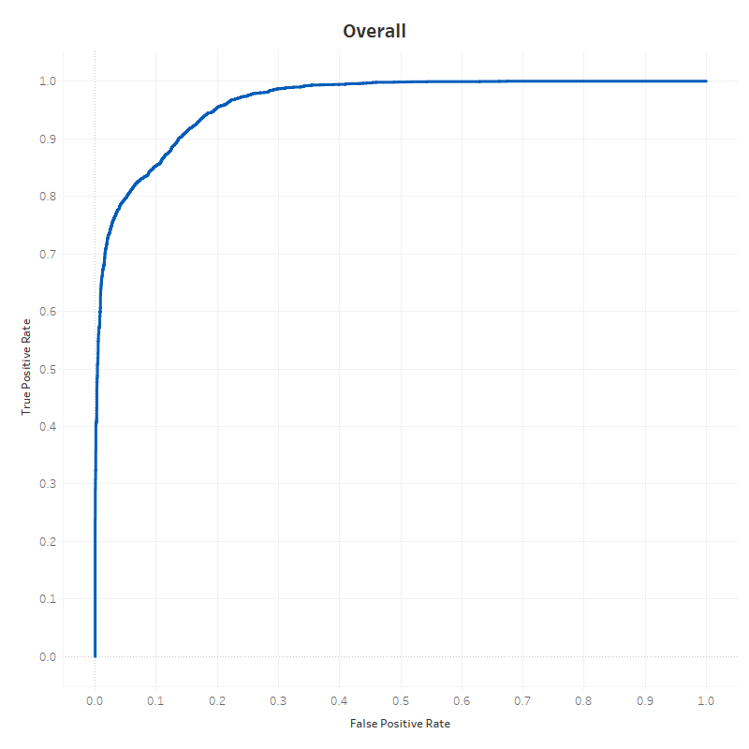
Model performance: ~96% accuracy
Promising results with this architecture
Also tried multi channel CNN models – limited by available compute
Good performance on Indo European and Germanic languages Chinese, Japanese, Vietnamese language family performance not upto the mark
Require high quality labelled data for input languages

Slide 15
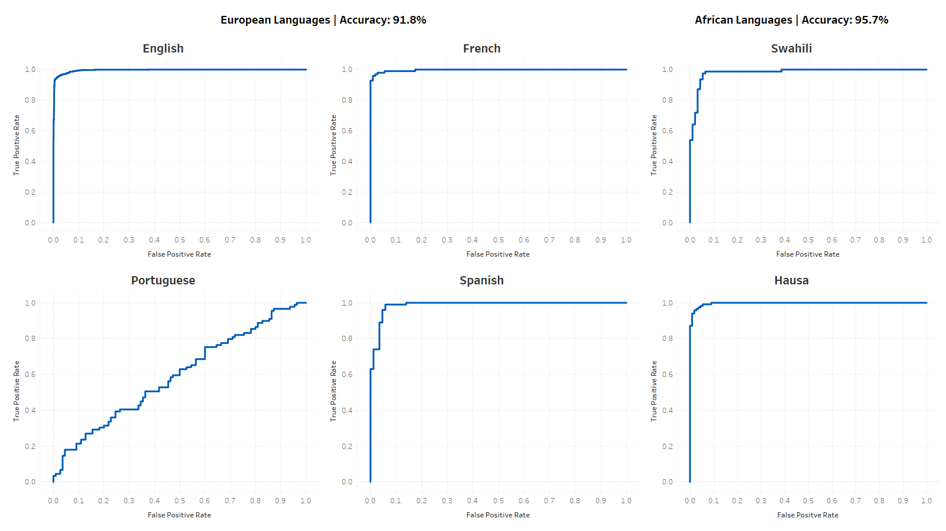
Promising results on European and African languages

Slide 16
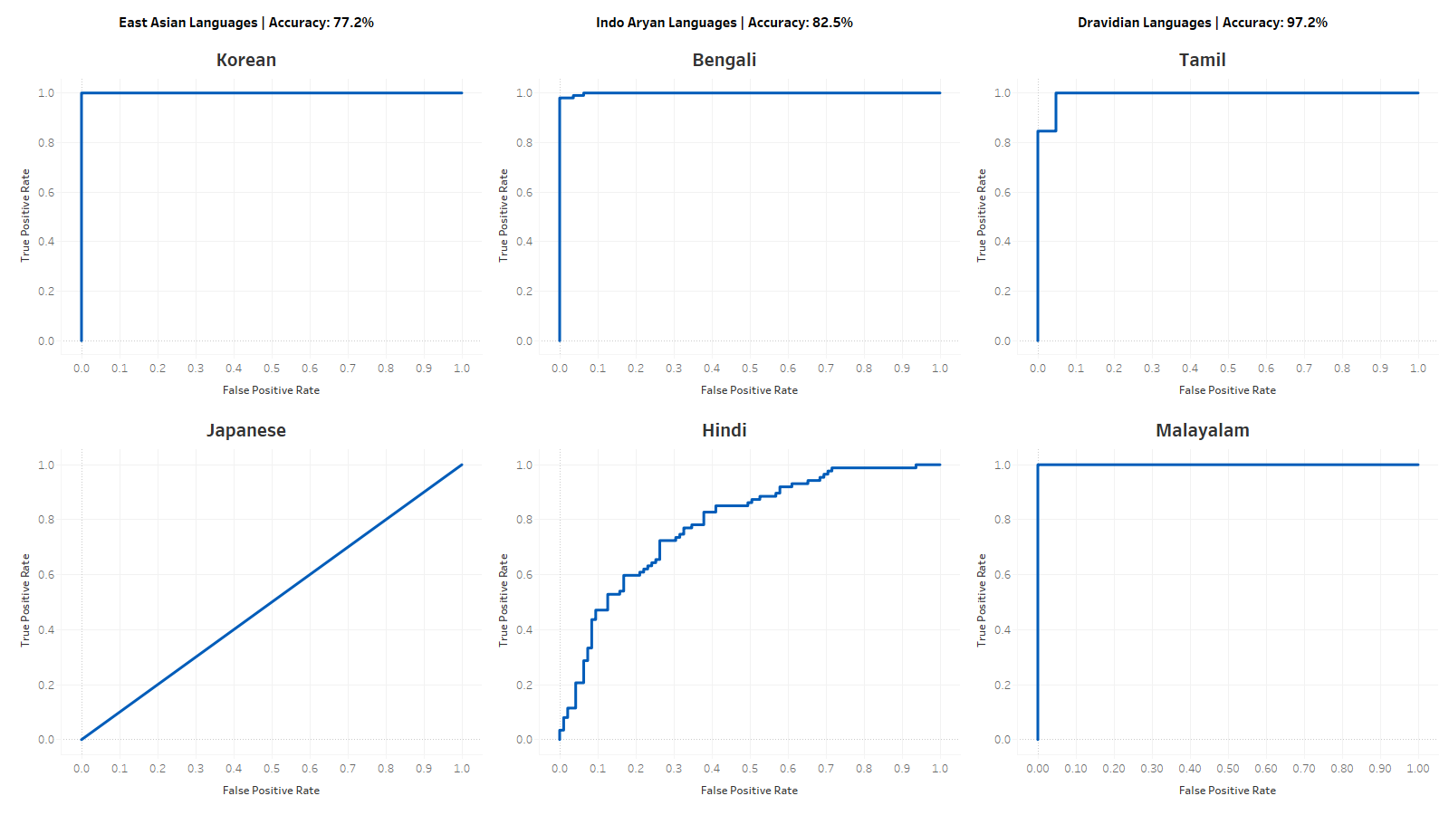
Results on East Asian, Indo-Aryan, Dravidian languages

Slide 17
Sample output
 | Text | Complexity | Score | Range
0 | Pullman, writer of the His Dark Materials trilogy, says authors and musicians work in poverty and obscurity for years to bring their work to the level that gives delight to their audiences and, as soon as they achieve that, the possibility of making a living from it is taken away from them. | Complicated | 78 | Red
1 | Known as Lady Dinahs Cat Emporium, it is yet to open but is billed as somewhere people can come in from the cold to a comfortable wingback chair, a hot cup of tea, a book and a cat. | Complicated | 90 | Red
2 | The activity in Western Australia is compounding the human tragedy of shark attacks. | Complicated | 61 | Amber
3 | Never being able to trust your friendships with people of different means, I think that is dif cult, said Cockrell. | Complicated | 66 | Amber
4 | The typical swimmer can hold their breath for about 40 seconds while underwater, he says. | Simple | 42 | Yellow
5 | Michael Day, 30, who lives with his parents in Bristol, says he has been caught between paying high rents and saving for a mortgage deposit. | Simple | 32 | Yellow
6 | I enjoy taking long walks in the park on sunny afternoons. | Simple | 2 | Green
7 | Vienna is the worlds best city to live in, Baghdad is the worst and London, Paris and New York do not even make it into the top 35, according to international research into quality of life. | Simple | 20 | Green
Legend
Complex (75 – 100)
Fairly Complex (50 – 74)
Fairly Easy (25 – 49)
Easy (0 – 24)

Slide 18



How will it work?
AWS S3 Bucket
AWS Sagemaker
Text to be scored gets uploaded to S3 bucket in CSV format
Sagemaker runs predictions using pre-trained model and scores the input
AWS Lambda
AWS S3 Bucket
File upload triggers lambda function to start Sagemaker instance
Model scores saved in S3 bucket in CSV format

Slide 19
AWS in action

Slide 20
What are the costs?
Trigger: add a file to S3 bucket
Instantiation: sil_readability_vq
Cost: $0.2 / million requests
Instance: ml.r5.8xlarge, 250GB
Lifecycle config: lifecycle-test-3
Cost: $2.419 / hour
Hourly usage scenario
Particulars | Price | Size & Time | Total
S3 | $0.023 | ~10M | $0.00
Sagemaker | $2.419 | 1 hour | $2.419
Lambda | $0.2 | 2 requests | $0.2
 |  |  | $2.619
LARA
Assuming 3000 texts per CSV
Bucket: purdue-ip-2023-readability
Input directory: sil2-pred/
Cost: $0.023 / GB

Slide 21









Solution benefits
Content Creation
Content Creation
Machine Translation
Machine Translation
50% of consumers are more likely to purchase when information presented in their own language For Profit Organization: Increase in sales from non-native speakers
Market size is expected to reach USD 1.5 billion by 2027
Technology Company: Potentially gain a competitive advantage
Education
Text Simplification
Text Simplification
Journalism and Publishing
Journalism & Publishing
1 in 5 adults in the US have low literacy levels (National Assessment of Adult Literacy) Govt. Agency: Improve access to justice for millions of citizens with low literacy levels
50% of consumers access news content through digital platforms
Media Company: Potentially increase readership and revenue from non-native speakers
Education
250 million primary school-aged children are unable to read, write, or do basic math Non-profit organization: Positive impact on millions of students

Slide 22


Future scope
More Languages
Train with additional data, representative of many languages
Attach EBS
33% time savings during instantiation when AMI stored on an Elastic Block Storage
Calibrate Embeddings
Fine tune LaBSE embeddings for classification task
Hugging Face Repo
Transition from AWS pipeline into a HF repository

Slide 23
Amal Tom
Mrinmoy Dalal
Sankarsan Gautam
Shreyas Joshi
Vedanti Gulalkari
Venkatesh Seetha
BAIM ANALYTICA
Thank You!

Slide 24
Questions?

Slide 25
APPENDIX

Slide 26
PRELIMINARY ANALYSIS – WHITE SPACE AND SCRIPT TYPE DISTRIBUTION
Only 3 languages with no white spaces – challenge
Most languages have 500 text pairs
Only 2 languages have less than 100 pairs – may prove to be difficult to train a model
Distribution of sentence pairs by white_space and script_type

Slide 27
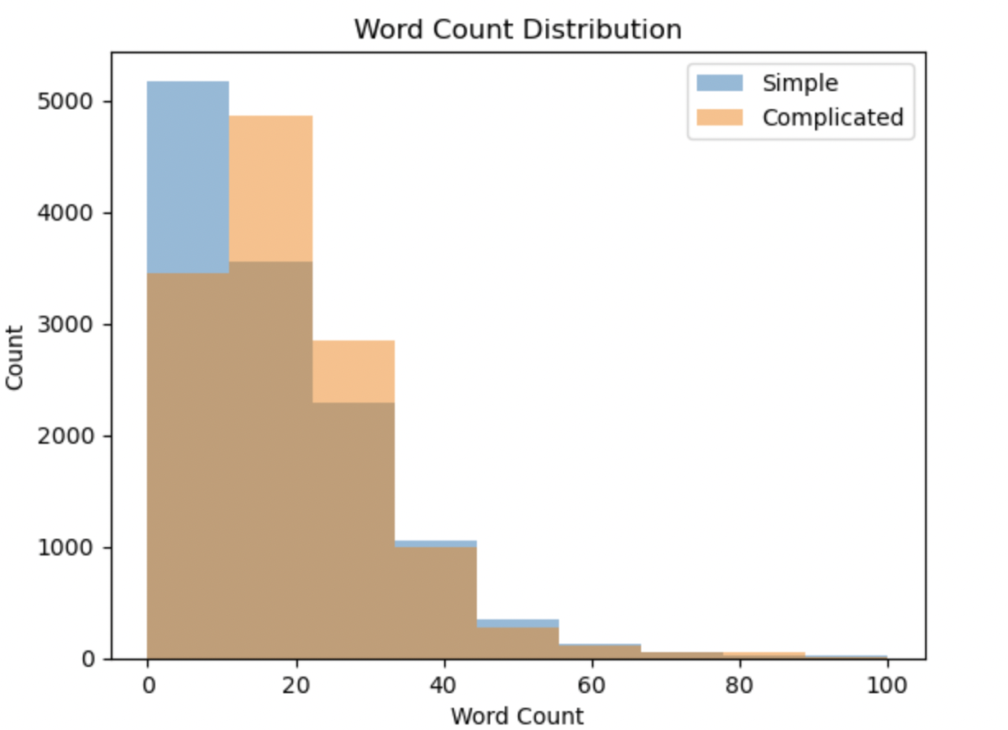
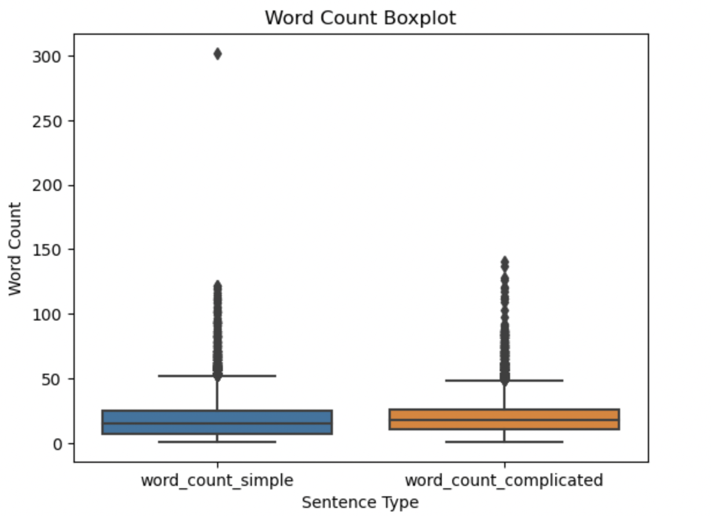
PRELIMINARY ANALYSIS – WORD COUNT
Comparison of word count distribution in simple and complex sentence pairs
Complex sentences have only slightlyhigher median word count when compared to simple sentences

Slide 28
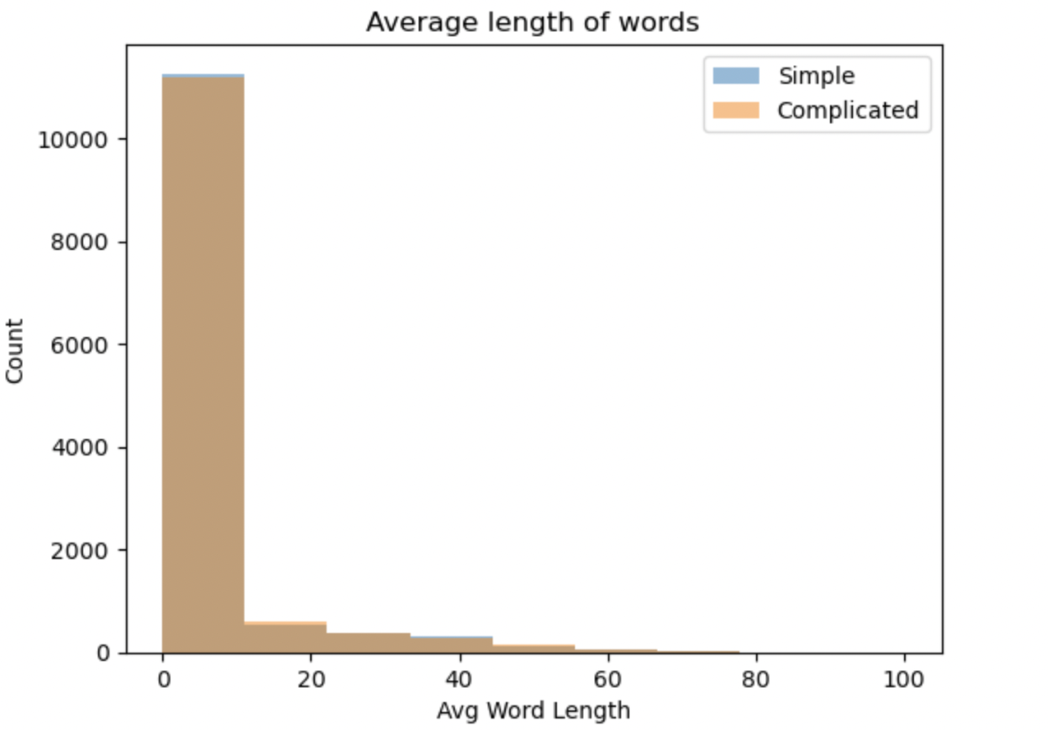
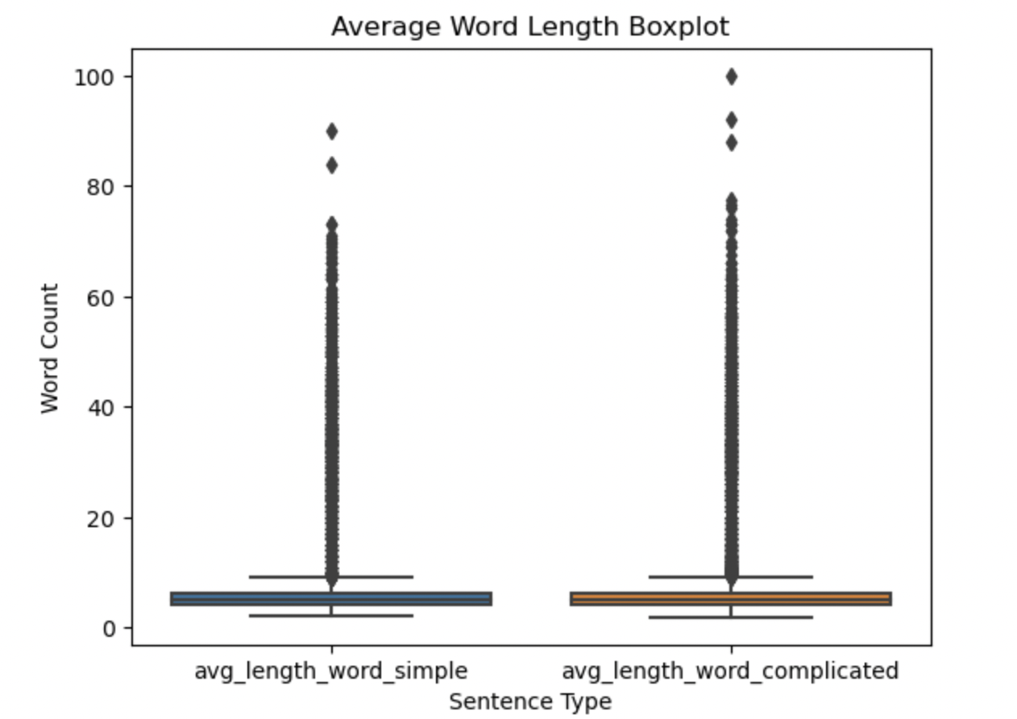
PRELIMINARY ANALYSIS – WORD LENGTH
Comparison of average word length in simple and complex sentence pairs
Average length of words is similar across simple and complex sentences

Slide 29
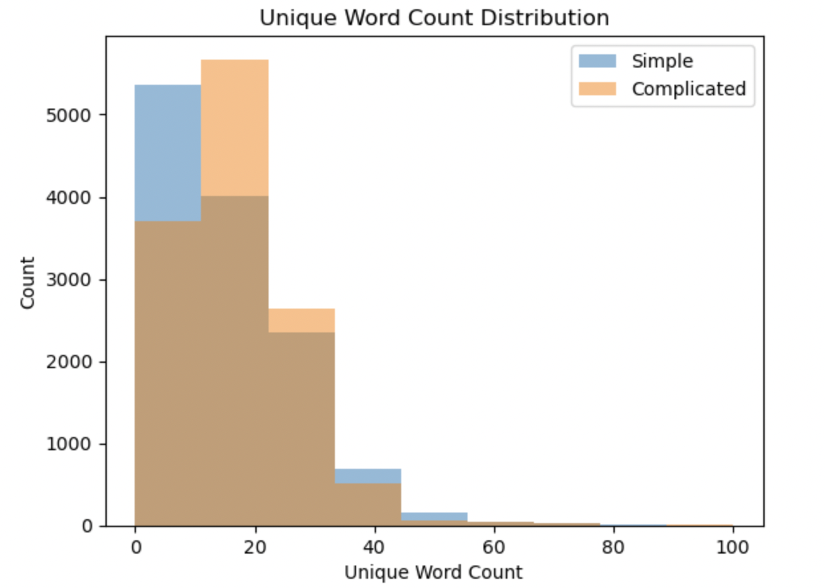
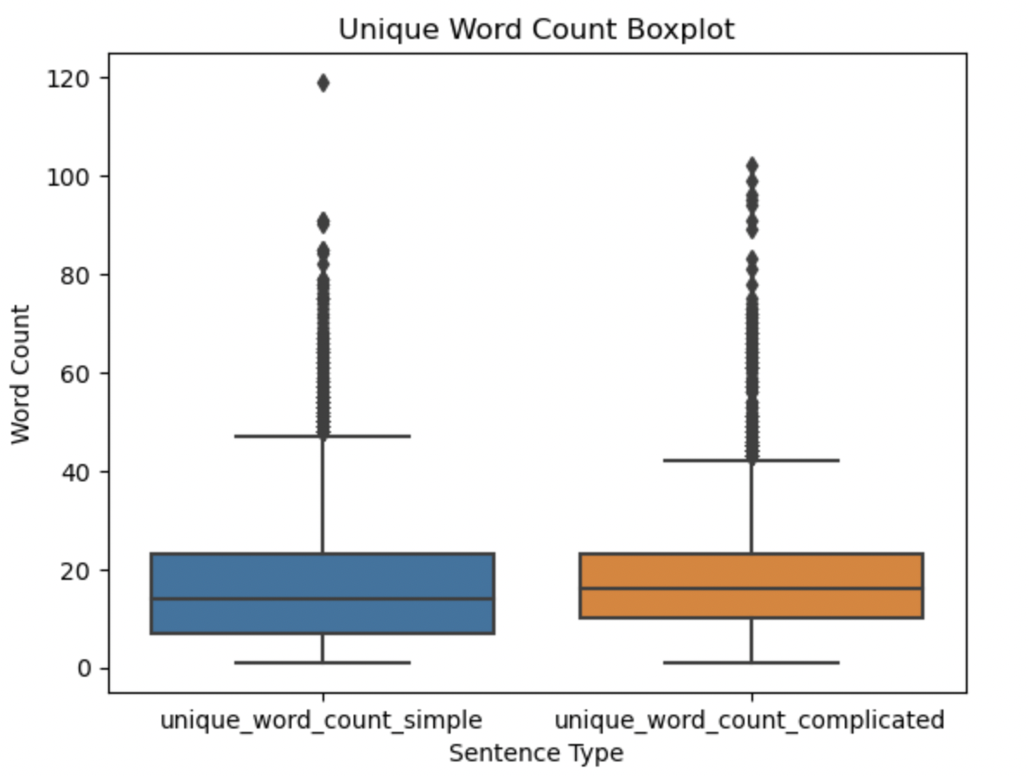
PRELIMINARY ANALYSIS – UNIQUE WORD COUNT
Comparison of unique word count distribution in simple and complex sentence pairs
Simple sentence use less unique words than their complicated counterparts

Slide 30
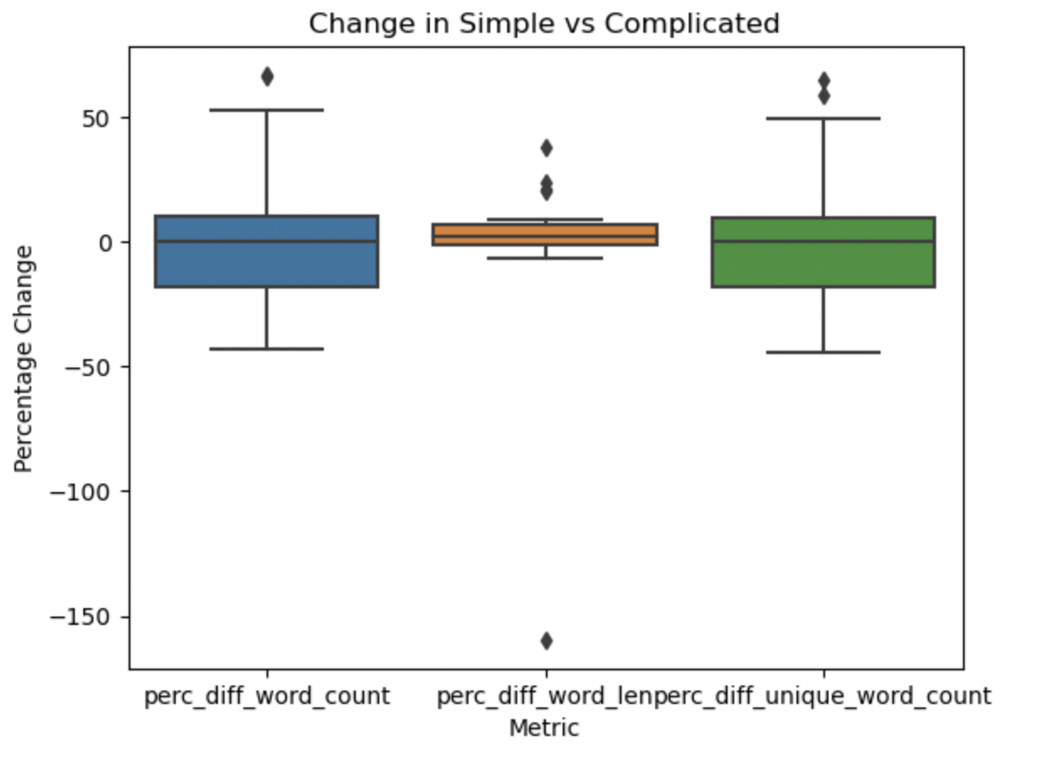
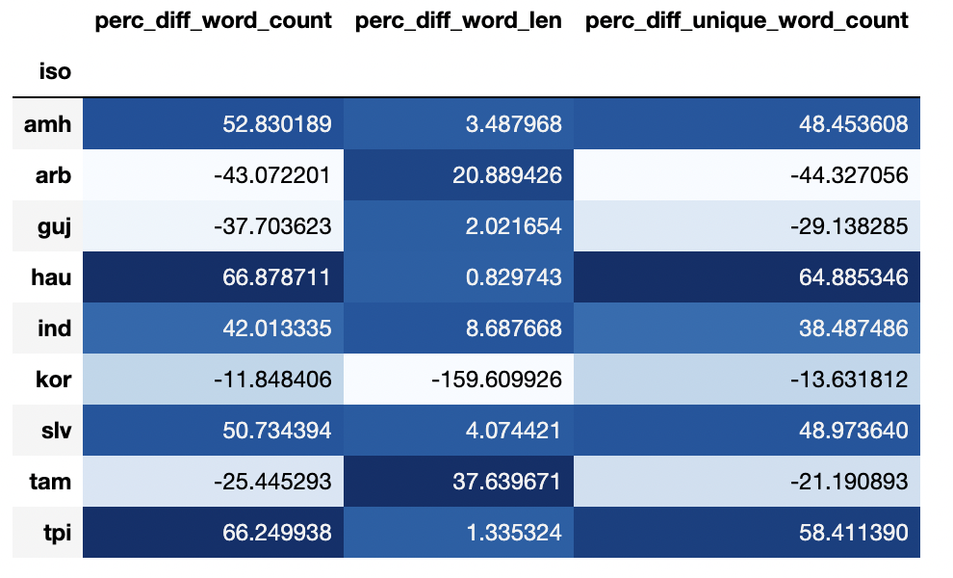
PRELIMINARY ANALYSIS – LANGUAGES WITH MOST VARIATION
Languages with most significant word count, word length and unique word count variations

